Slide 1
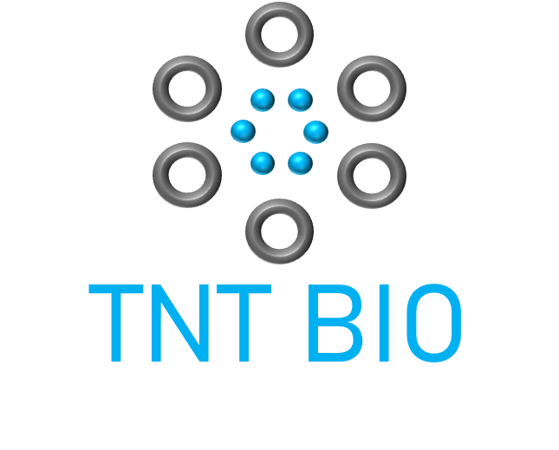
UNC/Duke Case Competition 2020
Jefferson Pike Jr. Pharm.D. Candidate
Erin Burgunder Scholz Ph.D. Candidate
Amy Guisinger MPH, Pharm.D. Candidate
Andrew Stenger
Pharm.D. Candidate
Blasting away the toughest immune conditions
Notes:
Hello, I’m Jefferson Pike [others introduce] and thank you creating this virtual case competition opportunity!
We are thrilled to present our recommendation and analysis for TNT Bio.

Slide 2
Agenda
0
Executive Summary + Introduction
I
Competition
II
Market size
III
Value to stakeholders
IV
Likelihood of approval
V
Conclusion
Notes:
We will begin with an executive summary and provide some introductory information, then drill into the 4 key arms of our analysis. Finally, we will conclude by looking to the future with some risks and next steps.

Slide 3
Executive Summary
Situation
TNT-Bio should focus on TNT-002 for its strategic expansion into atopic dermatitis
Key question
TNT-Bio should focus on TNT-002 for its strategic expansion into atopic dermatitis
TNT Bio is a public, small-to-mid sized biopharma company focused on developing immunology medicines
They are seeking to expand 1 of 2 existing immunology assets into atopic dermatitis (AD)
Which one of these two assets should be entered into phase I clinical development for AD?
TNT-013
TNT-002
Recommendation
TNT-Bio should focus on TNT-002 for its strategic expansion into atopic dermatitis
Impact
TNT-Bio should focus on TNT-002 for its strategic expansion into atopic dermatitis
TNT Bio should focus on TNT-002 for its strategic expansion into atopic dermatitis
Achieve $1.13 B peak annual sales in the atopic dermatitis space
0
Notes:
TNT Bio is a public, small-to-mid sized US biopharma company that was recently spun out of a larger company to focus on developing immunology drugs.
They brought our team in to answer the key question – which one of two promising agents should they pursue for phase I clinical development in atopic dermatitis?
After examining 4 key factors, we recommend that TNT-002 is the clear choice based on its less crowded competitive landscape, blockbuster commercial potential, and unique mechanism of action that could deliver more value to stakeholders.
With successful clinical development and purposeful commercial partnership, we project peak sales of over $1 B per year for TNT-002.

Slide 4
Introductory Information
SCENARIO: TNT Bio is seeking to expand one of their existing immunology assets into atopic dermatitis (AD)
TNT-013
Injectable anti-IL-13 monoclonal antibody
Completed Phase II testing for asthma
TNT-002
Topical TYK2 inhibitor
Currently in Phase I testing for RA
GOAL: Evaluate the opportunity for each program and recommend one agent to develop in AD
US adult AD
prevalence
US child AD
prevalence
MILD AD
MODERATE AD
SEVERE AD
7.3%
Topical corticosteroids (TCS)
Topical calcineurin inhibitors (TCI)
Emollient creams
High-strength TCS, TCI, PDE4 inhibitors
Phototherapy
Emollient creams
Biologics (inj.)
Oral corticosteroids
Phototherapy
Emollient creams
10.7%
0
Notes:
While both of TNT-Bio’s assets are promising, they differ considerably:
TNT-013, is a subcutaneous injectable biologic targeting the IL-13 receptor
TNT-002, a topical TYK2 inhibitor that falls under the JAK inhibitor family of immune agents
AD, also known as eczema, is an itchy, inflammatory skin condition in which rashes can develop on the cheeks, arms, and legs. Staging the severity of atopic dermatitis is difficult. Factors like body surface area are used to generate severity scores in clinical trials, however, in clinical practice, classifying severity relies on provider judgment.
Atopic dermatitis commonly begins in childhood, and spontaneously resolves before adulthood in 70% or more cases.
For patients with a mild outbreak who require medicine, 1st-line topical agents include corticosteroids, calcineurin inhibitors, and PDE4 inhibitors
For more severe cases, treatments might involve higher-potency corticosteroids or the injectable biologic agent DUPIXENT, which like TNT-013, blocks the IL-13 mechanism to control inflammation.

Slide 5
Framework
TNT Bio should focus on developing TNT-002 for atopic dermatitis based on performance across 4 categories:
 |  | TNT-013 |  |  |  |  |  | TNT-002
I | Competition
II | Market size
III | Value to stakeholders
IV | Likelihood of approval
0
Notes:
In approaching this case, our team came to the conclusion that TNT-Bio should focus on TNT-002 for atopic dermatitis by comparing its assets across 4 categories:
Competition, both now and projected through the next 10 years
Market size, considering the potential indications for each agent and plugging in their projected market shares based on competition
Value to stakeholders, based on sentiments from the literature around currently approved AD agents
Likelihood of approval, both for the agents’ potential AD clinical programs and across co-developing indications

Slide 6
Current competitive dynamics heavily favor TNT-002
Analogs
Same class
Same Indication*
DUPIXENT® is an entrenched competitor for TNT-013
TNT-013 is threatened by ph. III analogs that boast oral routes of administration
Despite a saturated topical market, TNT-002 does not yet have any launched class competitors
6+ active brands; numerous generics
Launched
DUPIXENT®
Phase III
TNT-013 comparator, moderate-to-severe AD
7
10+
Phase I/II
TNT-002 comparator, mild-to-moderate AD
9+
Color intensity = threat of competition (illustrative)
I
“Analog” = overlapping indication + mechanism of action * Pipeline drugs without a disease severity focus were excluded
Notes:
We analyzed the competitive landscape in atopic dermatitis, and determined that current dynamics heavily favor TNT-002.
In this figure, we cross-matched competitors by the directness of their competition and stage of development. The greatest threat of competition is posed by drugs that are analogs, meaning they share the same MoA and indication, and are already on the US market.
DUPIXENT is currently the only approved agent indicated for moderate-to-severe AD, and meaning it has a jumpstart on TNT-013. Additionally, 2 more IL-13 inhibitors are in phase III testing with an oral route of administration. If approved, these agents would likely have a strong market advantage over TNT-013.
Our third takeaway here is that despite having lots of marketed generic competitors, TNT-013 does not yet have any launched class competitors, although there is one analog, a topical version of JAKAFI in phase III testing.

Slide 7
TNT-002 can achieve >5x the market share of TNT-013
 | Competitor | 2020 | 2021 | 2022 | 2023 | 2024 | ‘25 – ‘29
TNT-013 Competition | DUPIXENT® | Pediatric expansion |  | Infant expansion
 | Lebrikizumab |  | Approval (65%)
 | Tralokinumab |  |  | Approval (68%)
 | ASLAN004 |  |  |  |  |  | Approval (16%)
 | Other class comparators |  | Approval (68%) |  |  | Approvals x7 (16 – 24%)
 | Indication competitors |  | Approvals x4 (61 – 71%) |  | Approvals x10 (16 – 24%)
TNT-002 Competition | Ruxolitinib Cream | Completing ph. III | Approval (62%)
 | PF-06700841 |  |  | Approval (24%)
 | Other class comparators |  | Approvals x3 (68 – 71%) |  |  | Approvals x3 (16 – 27%)
 | Indication competitors |  | Approval (71%) |  | Approvals x7 (16 – 24%)
Projected competition:
2 analogs
2 class competitors
4 other competitors
Adjusted market opportunity for TNT-013: 7.2% market share
Projected competition:
1 analog
3 class competitors
2 other competitors
Adjusted market opportunity for TNT-002: 40.3% market share
I
(xx%)–likelihood of approval. Analog–overlapping indication + mechanism of action.
Data from Informa BioMedTracker and ClinicalTrials.gov
Notes:
In addition to surveying the current state of competition, we analyzed potential US market approvals over the next 10 years to represent the competitive dynamics that one of TNT Bio’s agents would be up against upon launch.
Considering the likelihood of approval for each medicine in the pipeline, we projected a peak market share capture for TNT-002 that is 5x greater than that of TNT-013. The direct analogs with superior routes of administration and crowded pipeline for moderate-to-severe AD makes it much more difficult for TNT-013 to differentiate in this space.

Slide 8
TNT-002 has the largest eligible patient population
TNT-013
TNT-002
7.3% of US adults* have AD
37% diagnosed
40% moderate-to-severe
58.7% poorly controlled
2% adoption rate
All Americans with AD
37% diagnosed
64% Mild-to-moderate
58.7% poorly controlled
10% adoption rate
18.5 M
26.4 M
6.9 M
9.8 M
2.7 M
6.1 M
1.6 M
3.6 M
32,189
355,702
*Upon indication expansion, TNT-013 could additionally be used in a population of 11,258 children with uncontrolled moderate-to-severe AD
II
Notes:
These $ amounts assume:
All people calculated to have AD (based on prevalence data) actually do
Everyone who actually has AD is diagnosed
Everyone who is diagnosed with AD seeks treatment/remains on treatment for a year
Capture of the entire available market (ie competition is negligible) and all patients who have AD seek treatment for AD

Slide 9
TNT-002 offers the largest commercial opportunity
Attribute |  |  | TNT-013 | TNT-002
Revenue potential per patient |  |  | $43,542/year* | $7,827/year**
Patient Segment | Mild-to-moderate | Children | - | 355,702 patients
 |  | Adults | -
 | Moderate-to-severe | Adults | 32,189 patients | -
Market size |  |  | $1.4 B/year | $2.8 B/year
Market share |  |  | 7.2% | 40.3%
Peak annual sales |  |  | $101 M/year | $1.13 B/year
*Based on wholesale acquisition cost of leading marketed competitor Dupixent
**Based on wholesale acquisition cost of leading marketed competitor Eucrisa
II
Notes:
These $ amounts assume:
All people calculated to have AD (based on prevalence data) actually do
Everyone who actually has AD is diagnosed
Everyone who is diagnosed with AD seeks treatment/remains on treatment for a year
Capture of the entire available market (ie competition is negligible) and all patients who have AD seek treatment for AD

Slide 10
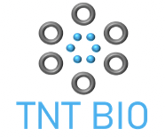
Across current AD therapies, topical corticosteroids provide greatest value
Stakeholder | Attribute |  | Topical Corticosteroids |  |  |  |  |  | Topical Calcineurin Inhibitors
Patients | Ease of use
 | Administration
 | Cost
 | Adherence
 | Patient Preference
 | Composite
Providers | Disease severity
 | Patient profile
 | Formulary tier
 | Composite
Payers | Budget impact
 | Place in therapy
 | Composite
Manufacturer | Manufacturing costs
 | R&D costs
 | Composite
EUCRISA® (PDE4 inhibitor) topical ointment
DUPIXENT® (anti-IL-13 & anti-IL-4) SQ injectable therapy
III
Okubo Y, et al. J Dermatolog Treat. 2019
Schaarschmidt ML, et al. J Eur Acad Dermatol Venereol. 2013
Bass AM, et al. J Clin Med. 2015
Feldman SR, et al. Am Health Drug Benefits. 2019
Clark R, et al. J Med Econ. 2018
Notes:
In order to demonstrate the value to stakeholders, our team investigated current atopic dermatitis treatments and ranked the proposed value of these therapies to patients, providers, payers, and manufacturers.
Factors deemed beneficial to patients when considering the value of AD therapies include ease of use, other administration burden, cost, patient adherence, and overall patient preferences based on current literature. Ease of use is a composite of convenience in terms of dosing schedule and physical barriers to administration, while other administration burden depicts place of administration – where at home administration would be scored higher than therapies to be administered in a clinic setting only. The prescription costs were defined as the total prescription cost to patients for a 30 day supply. Interestingly enough, evidence suggest that patients actually have a higher preference towards injectable therapies because they believe these to be more efficacious, which also leads to higher rates of adherence. Reports also indicate that patients have ”steroid phobia” and are concerned with side effects of topical steroid regimens, making this regimen less preferred among most patients.
Factors deemed beneficial for providers include comorbid indications, disease severity indications, and formulary tier placement based on the 2019 OptumRx Prescription Drug Plan data. Comorbid indication scoring factored in whether or not a pre-existing patient population or populations at risk for developing AD were prescribed the current regimen. For example, patients with severe atopic dermatitis are more likely to develop other allergic conditions, such as asthma. Topical steroids remain in Tier 1, while the other 3 regimens remain in tier 2, with topical calcineurin inhibitors and Crisaborole requiring patients to have tried a TCS prior to initiation. TCS is also indicated for all disease severities and infants, children and adults, whereas Dupilumab is only indicated for adults and moderate-severe disease classification.
Factors deemed beneficial for payers include the proposed budget impact and the medications’ place in the AD treatment algorithm. While topical corticosteroids have the greatest budget impact, most versatile usage, and are considered first-line treatment agents, dupilumab’s recent indication for AD is associated with profitable gain compared to crisaborole in terms of a budget impact analysis if Dupilumab were to be adopted.
Lastly, factors deemed beneficial for manufactures include R&D costs and the associated manufacturing costs to produce these products. Dupilumab is associated with higher production costs due to the high costs associated with producing biologic products.
Composite rankings for these current therapies indicate that topical corticosteroids are the most valuable to consumers and stakeholders, followed by Crisaborole, dupilumab, and topical calcineurin inhibitors.

Slide 11
TNT-002 may offer slightly more value to stakeholders
Stakeholder | Attribute |  | TNT-013 |  |  |  |  |  | TNT-002
Patients | Ease of use
 | Adherence
 | Cost
 | Patient preference
 | Composite
Providers | Comorbid indications
 | Disease severity
 | Composite
Payers | Novel mechanism
 | Budget impact
 | Composite
Manufacturer | Manufacturing costs
 | R&D costs
 | Composite
III
Notes:
The value matrix determined in the previous slide was used to extrapolate the proposed value of TN-013 and TN-002 to the same group of stakeholders. Overall TN-002 was shown to have the greatest proposed value. While patient preference indicates injectable therapies are preferred among most, TN-002’s low predicted prescription drug cost to patients and ease of use formulate a greater composite value.
Data suggest that 60 to 70% of asthma patients have comorbid atopic dermatitis. Those with severe asthma are indicated for treatment with IL-13 inhibitors, such as Dupilumab, making TN-013 the preferred agent among providers and suggests there may already be a historical patient population in place. However, atopic dermatitis topical regimens span a wide range of disease severities, making TN-002 the preferred agent in terms of disease severity.
TN-002 also has a novel mechanism of action and no other competing candidates on the market, making this a preferred regimen to payers. However, due to its’ novel mechanism, manufacturers may have more R&D costs associated with development, but lower manufacturing costs when compared to the costs to manufacture biologic therapies.
So, putting it all together, TN-002 demonstrates the highest value to patients, providers, payers, and manufacturers.

Slide 12
Regulatory approval odds of co-developing indications
TNT-013 may allow for greater efficiency in atopic dermatitis launch over TNT-002
TNT-013: Asthma Clinical Development
Phase 1 | Phase 2 | Phase 3 | Approval
Completed (100%) | Completed (100%) | 71.1% | 94.6%
TNT-002: Rheumatoid Arthritis Clinical Development
Phase 1 | Phase 2 | Phase 3 | Approval
65.7% | 31.7% | 62.2% | 86.0%
67.2% chance of approval
11.1% chance of approval
IV
BIO Clinical Development Success Rates 2006-2015. 2016.
Notes:
The last bucket our team analyzed was the “Likelihood of approval” for both products which boils down to trends throughout the entire regulatory and payor space
Specifically within internal and on-going clinical development → TNT-013 may allow for greater efficiency in atopic dermatitis launch over TNT-002
TNT-013 = demonstrated potential for superiority over standard of care in asthma in a Phase 2 trial
TNT-002 = currently in a Phase 1 trial for rheumatoid arthritis
As we can see here, completing phase 2 = major milestone in the drug development process for TNT-013
Post completing phase 2, TNT-013 stands at about a 70% change of approval vs. an 11% chance of approval for TNT-002
Beyond overall approval chances, TNT-013 stands at a greater chance for other advantages like:
Workforce synergies
Long term benefits of our sales team not having to learn a new product
Shorter time frame for commercialization by being familiar with the product landscape
Large co-morbid correlation between asthma and atopic dermatitis (as Amy noted in our value to stakeholders analysis) → this will drive market up-take for both indications

Slide 13
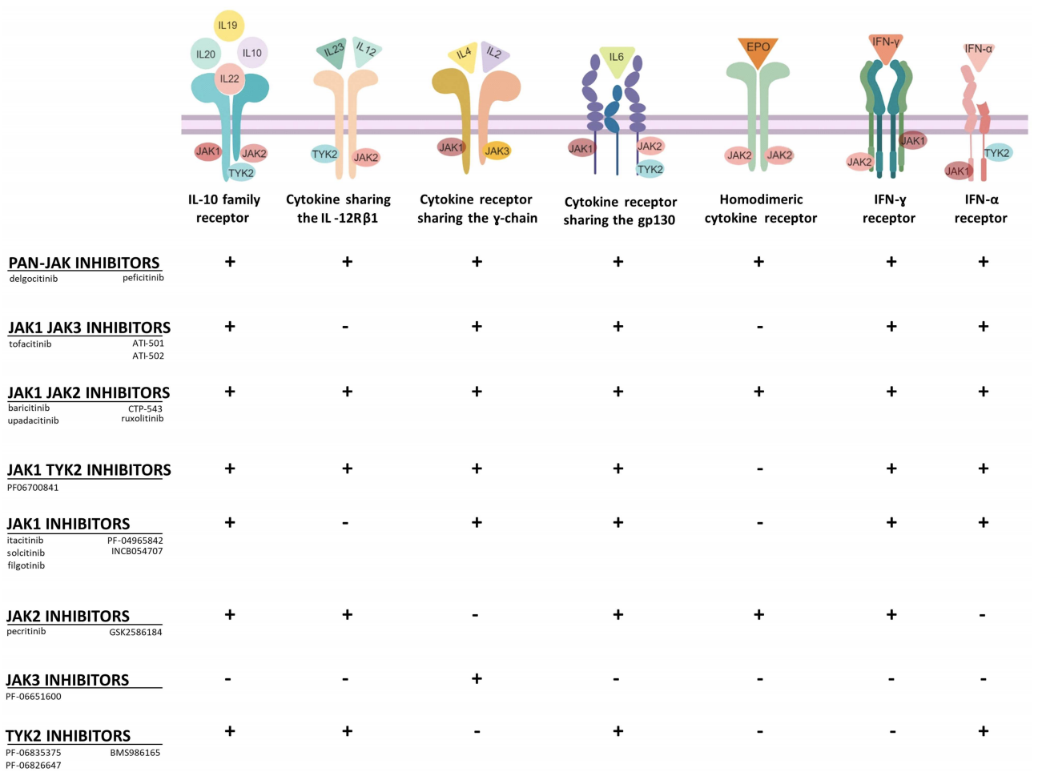
Clinical Development Landscape
TNT-002 may align more closely with growing rhetoric in the atopic dermatitis space
AD is defined beyond Th2 cells and related cytokines
Patients present with different cytokine signatures at different stages of disease
JAK inhibitors interfere with the signaling of multiple cytokines simultaneously
Solimani F, et al. Front Immunol. 2019.
Weidinger S, et al. Lancet. 2016.
Amano W, et al. J Allergy Clin Immunol. 2015.
IV
Notes:
https://www.ncbi.nlm.nih.gov/pmc/articles/PMC6901833/
Within the overall clinical development and regulatory environment → TNT-002 may align more closely with growing rhetoric in the atopic dermatitis space
As patients continue to present with atopic dermatitis:
Providers are finding that the cytokine microenvironment is growing more complex → beyond Th2 cells and related cytokines (IL-13, IL-4, etc.)
Patients seem to present with different cytokine signatures at different stages of disease
Growing interest toward JAK inhibitors which could interfere with the signaling of multiple cytokines simultaneously

Slide 14
Assumptions
Competition |  | Market size |  | Value to stakeholders |  | Likelihood of approval
Threat of competition is determined by development stage & overlap in MoA, indication, and route of administration Competition reduces commercial opportunity by: 70% for analogs with more convenient RoA 50% for other analogs 5% for class competitors 3% for indication competitors TNT-013 will pursue moderate-to-severe AD indication and TNT-002 will pursue mild-to-moderate indication |  | Assumptions and statistics are based on scientific literature and market research: 37% diagnosis and treatment rate¹ 40% of adults have moderate-to-severe AD² 33% of children have moderate-to-severe AD³ 58.7% of patients’ AD is uncontrolled (on or off treatment)⁴ 2% adoption rate for TNT-013 10% adoption rate for TNT-002 |  | Stakeholder values extrapolated from current literature on currently-approved medicines |  | Both TNT-013 and TNT-002 gain FDA approval without significant hurdles and/or complications during the drug development process
¹Hanifin JM, et al. Dermatitis. 2007
²AD in America PDF. www.aafa.org
³Boguniewicz M, et al. Ann Allergy Asthma Immunol. 2018
⁴Wei W, et al. J Dermatol. 2018
0
MoA – mechanism of action, RoA – route of administration, Analog–comparator with overlapping indication + mechanism of action
Notes:
Here we’re presenting the key assumptions used for our analysis
I won’t read through them
But please do feel free to refer back here if necessary

Slide 15
Conclusion
Recommendation:
TNT Bio should focus on TNT-002 for its strategic expansion into atopic dermatitis
Rationale
TNT-002 has a more favorable competitive landscape
TNT-002 has a potential blockbuster market opportunity
TNT-002 has a novel mechanism of action that brings more value to stakeholders
Risks
No discernible market advantage over analogs, so market share capture is not guaranteed
Potentially less workforce synergy when pursuing AD indication for TNT-002 instead of TNT-013
No commercial roadmap as of yet for medicines in this class in AD
Next steps
Determine optimal pricing with quantitative market research
Research global market opportunities
Consider finding a partner with a global immunology commercial team
V
Notes:
Recommendation
Rationale
Inherent risks with pursing TNT-002 for expansion into the atopic dermatitis space
Next steps for TNT-Bio can be used to mitigate risks
As epidemiology data points to AD growing faster in regions outside of the US (places like Africa, Latin America, Europe, etc.)
TNT-Bio is an early stage AD company and could cut down on commercial workforce costs via partnership with a company with an establish AD portfolio
US patent infringement case (Dupixent) #8,679,487
Biomarker analysis can be included if needed

Slide 16
UNC/Duke Case Competition 2020
Jefferson Pike Jr. Pharm.D. Candidate
jefferson_pike@unc.edu
Erin Burgunder Scholz Ph.D. Candidate
eburg007@email.unc.edu
Amy Guisinger MPH, Pharm.D. Candidate
aguising@email.unc.edu
Andrew Stenger
Pharm.D. Candidate
andrew_stenger@unc.edu
Blasting away the toughest immune conditions

